Slide 1
20 GUI
swli@cug.edu.cn

Slide 2
four basic areas of functionality
Creation of user interface "controls" or components, such as scroll bars, buttons, and labels.
Support for giving behavior to the controls by connecting GUI events (for example, clicking a button) to code that you write.
Support for grouping and arranging the controls on the screen.
Support for accessing window manager facilities, such as specifying which window has the input focus, reading JPEG and other image files, and printing

Slide 3
AWT(Abstract Window Toolkit)
the first couple of major releases
The AWT is a series of abstract interfaces along with Java code to map them into the actual native code on each system
  it offers the same API on all
JDK 1.1 new event model
  JFC
JDK1.2 JFC, Extends to Swing
  almost wholly implemented in Java

Slide 4
Java GUI programs
1. Declare controls.
2. Implement event handlers
3. Add the controls to a container

Slide 5
event-driven programming
Instead of one flow of control from beginning to end, the run-time system sits in a "window main loop" simply waiting for user input.
When the user clicks the mouse, the operating system passes it to the window manager which turns it into an event and passes it on to a handler you supplied earlier. This is known as a callback(回调).
Your handler is a callback routine, because the window system calls back to it when the event happens. Your event handler deals with the graphics event and any work associated with it.
Notes:
可以增加Windows 消息循环部分

Slide 6
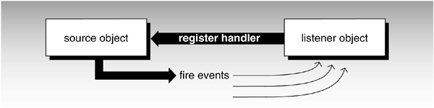
Java event model
JDK 1.1 introduced a better approach called the delegation-based model
The events that are fired from the source to the listener are simply objects passed as arguments to a method call.

Slide 7
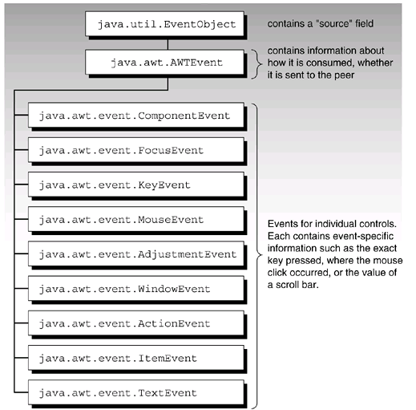
Java event model
  An event object has several data fields holding information, such as where the event took place on the screen, a description of the event, the number of mouse clicks, the state of a checkbox, and so on

Slide 8
The JFrame example
FrameDemo.java
  JFrame ->Frame?
  JFrame is a subclass of Frame, which is a subclass of Window
The same framework is used by all the event handlers:
  closeDemo.java
    Or jframe.setDefaultCloseOperation(
    JFrame.EXIT_ON_CLOSE);
  Write a class that implements a SomethingListener interface.
Notes:
1.我们所有的例子都以JFC的内容为主
1，如何更面向对象？
2.派生JFrame类，
3.JFrame点击关闭按钮窗口关闭了，但是程序没有结束
Frame点击关闭按钮窗口时，窗口没有关闭
4.比较两个界面的差别
Code:
import javax.swing.*;
public class FrameDemo {
public static void main(String[] args) {
JFrame jframe = new JFrame("Example");
jframe.setSize(400,100);
jframe.setVisible(true);
// you will need to Ctrl-C out of the program
// Uncomment the code below so that the program
// exits when you click on the Window close icon.
// jframe.setDefaultCloseOperation(JFrame.EXIT_ON_CLOSE);
}
}

Slide 9
The JFrame example cont.
  Declare an object (for example, myHandler) of your class.
  On your component, call the addSomethingListener(myHandler) method.
More event handle
  addKeyListener
    e.getKeyChar()
  addMouseListener
    e.getX()
  More …
Notes:
JOptionPane.showMessageDialog(null, "test");
2.import javax.swing.*;
import java.awt.event.*;
public class CloseDemo {
public static void main(String[] args) {
JFrame jframe = new JFrame("Example");
jframe.setSize(400,100);
jframe.setVisible(true);
myCodeToHandleWinClose m = new myCodeToHandleWinClose();
jframe.addWindowListener(m);
}
}
class myCodeToHandleWinClose implements WindowListener {
public void windowClosing(WindowEvent e) {System.exit(0);}
public void windowClosed(WindowEvent e) { }
public void windowOpened(WindowEvent e) { }
public void windowIconified(WindowEvent e) { }
public void windowDeiconified(WindowEvent e) { }
public void windowActivated(WindowEvent e) { }
public void windowDeactivated(WindowEvent e) { }
}

Slide 10
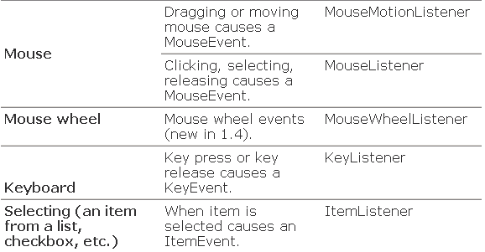

Categories, events, and interfaces

Slide 11
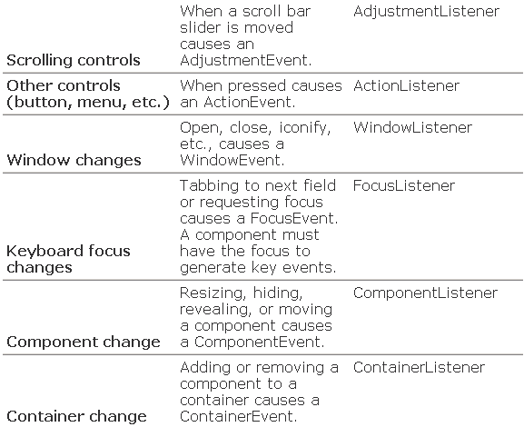

Slide 12
Slimming Down Handler Code
1.using an anonymous class
  Example code closeDemo2.java
2.Making a top-level class into a listener
  Example code closeDemo3.java
3.Using a listener adapter class
  Example code CloseDemo4.java
Notes:
1.使用netbeans插入代码
2:
import javax.swing.*;
import java.awt.event.*;
public class CloseDemo2 {
public static void main(String[] args) {
JFrame jframe = new JFrame("Example");
jframe.setSize(400,100);
jframe.setVisible(true);
jframe.addWindowListener( new WindowListener() { // anon. class
public void windowClosing(WindowEvent e) {System.exit(0);}
public void windowClosed(WindowEvent e) { }
public void windowOpened(WindowEvent e) { }
public void windowIconified(WindowEvent e) { }
public void windowDeiconified(WindowEvent e) { }
public void windowActivated(WindowEvent e) { }
public void windowDeactivated(WindowEvent e) { }
} ); // end of anonymous class.
}
}
3:import javax.swing.*;
import java.awt.event.*;
public class CloseDemo3 implements WindowListener {
public static void main(String[] args) {
JFrame jframe = new JFrame("Example");
jframe.setSize(400,100);
jframe.setVisible(true);
jframe.addWindowListener( new CloseDemo3() );
}
public void windowClosing(WindowEvent e) {System.exit(0);}
public void windowClosed(WindowEvent e) { }
public void windowOpened(WindowEvent e) { }
public void windowIconified(WindowEvent e) { }
public void windowDeiconified(WindowEvent e) { }
public void windowActivated(WindowEvent e) { }
public void windowDeactivated(WindowEvent e) { }
}
4:import javax.swing.*;
import java.awt.event.*;
public class CloseDemo4 extends WindowAdapter {
public static void main(String[] args) {
JFrame jframe = new JFrame("Example");
jframe.setSize(400,100);
jframe.setVisible(true);
jframe.addWindowListener( new CloseDemo4() );
}
public void windowClosing(WindowEvent e) {System.exit(0);}
}

Slide 13
Categories, events, and interfaces
Listener Interface | Adapter Class | Methods
ActionListener | 无 | actionPerformed
AdjustmentListener | 无 | adjustmentValueChanged
ComponentListener | ComponentAdapter | componentHidden componentMoved componentResized componentShown
ContainerListener | ContainerAdapter | componentAdded componentRemoved
FocusListener | FocusAdapter | focusGained focusLost
ItemListener | 无 | itemStateChanged

Slide 14
Categories, events, and interfaces
Listener Interface | Adapter Class | Methods
KeyListener | KeyAdapter | keyPressed keyReleased keyTyped
MouseListener | MouseAdapter | mouseClicked mouseEntered mouseExited mousePressed mouseReleased
MouseMotionListener | MouseMotionAdapter | mouseDragged mouseMoved
TextListener | 无 | textValueChanged
WindowListener | WindowAdapter | windowActivated windowClosed windowClosing windowDeactivated windowDeiconified windowIconified windowOpened

Slide 15
21.JFC and the Swing Package

Slide 16
Java Foundation Classes
Peer events must be translated into Java events before they can be handled by Java code in AWT.
  Worse, native libraries aren't identical on each platform, and sometimes the differences leak into the Java layer
  Example: AWT "file selection dialog"
JFC

Slide 17
Java Foundation Classes
pluggable look-and-feel, so that when you run the program, you can choose whether you want it to look like a Windows GUI, a Macintosh GUI, or some other style.
An accessibility API for features like larger text
The Java 2-D drawing API.
A drag-and-drop library and an "undo last command" library.
The Swing component set

Slide 18
Heavyweight VS lightweight components
use a peer or native component or not.
  Lightweight components can have transparent
  Mouse events on a lightweight component are delivered to its container
  When they overlap, lightweight components are never drawn on top of heavyweight components
not mix Swing JComponents with AWT components because of the poor behavior when overlapping.

Slide 19
Overview of JComponent
Size (preferred, minimum, and maximum).
Double buffering (a technique to make frequently changing components look smoother with less flickering).
Support for accessibility and internationalization.
Tooltips (pop-up help when you linger on a JComponent).
Support for operating the control with the keyboard instead of the mouse.
Some help for debugging by slowing component rendering so you can see what's happening.
The thickness of lines or insets around the edge of the control

Slide 20
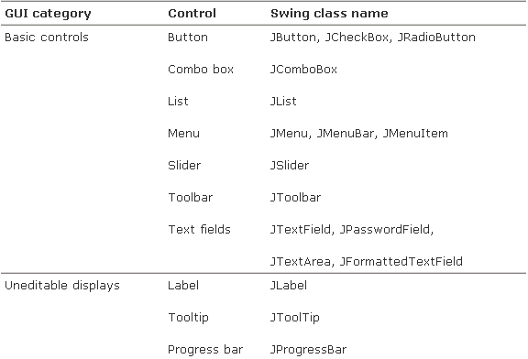
Swing lightweight controls
Table 21-1.
  Swing lightweight controls
  P326

Slide 21
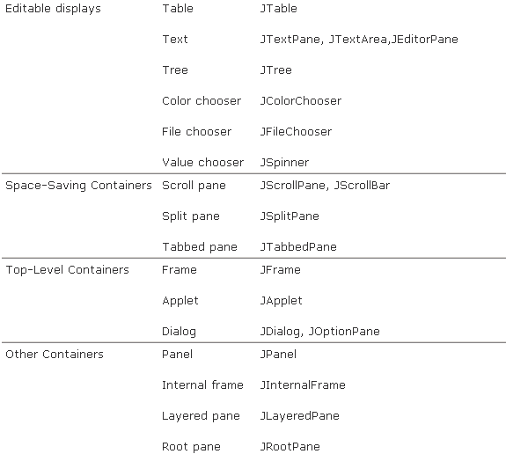
Notes:
09 111071-2 本章第一次课
不含 Chapter 19
可以包含进来，本部分 3次课

Slide 22
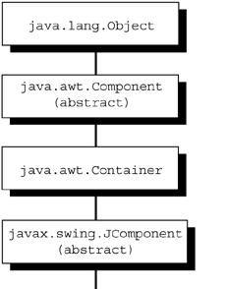
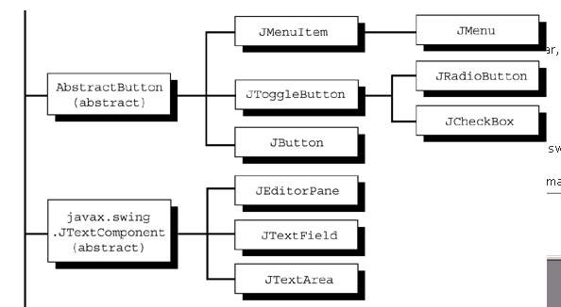
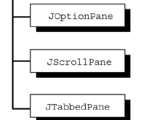
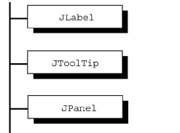
Swing lightweight controls
Notes:
08. 8th end
组合与继承

Slide 23
Use Jcomponent
1.Add them to a container
  MyJContainer.add( myJComponent );
  Before Jdk1.5
  MyJContainer.getContentPane().add( myJComponent );
2. Register your event handler using the addSomeListener() method of the control
applet: public static void init () {
Notes:
2009 111061-2 第七次课 本部分第一次课

Slide 24
display components
Example
  Demo.java
  public static void main(String[] args) {
  setupJFrame();
  JButton jb = new JButton("pressure"); jframe.getContentPane().add( jb ); jframe.setVisible(true);
  }
Notes:
import java.awt.*;
import java.awt.event.*;
import javax.swing.*;
public class Demo {
static JFrame jframe = new JFrame("Example");
public static void setupJFrame() {
jframe.setSize(400,100);
// The next line would be a bug! See "Swing Threads - A Caution!"
// jframe.setVisible(true);
jframe.setLayout( new FlowLayout() );
WindowListener l = new WindowAdapter() {
public void windowClosing(WindowEvent e) {
System.exit(0);}
};
jframe.addWindowListener(l);
}
public static void main(String[] args) {
setupJFrame();
JButton jb = new JButton("pressure");
jframe.getContentPane().add( jb );
jframe.setVisible(true);
}
}

Slide 25
Swing Threads
Swing requires that all code that might affect GUI components be executed from the event-dispatching thread (我不调用你，你调用我)
the only place where you should create, modify, set visible, set size, or otherwise adjust GUI components is in your event-handler code.
Method invokeLater();

Slide 26
Swing Components
Example in book:
  JLabel
    "<html>You are<br> a star<html>“
    Frame.pack();
  JButton
  JToolTip
  JTextField
    try to implement a listener for each keystroke
  JCheckBox
    JCheckBox jc=(JCheckBox)e.getItem();

Slide 27
Swing Components cont.
  JPanel
    JLabel (Extends JPanel)
    重载paint方法, 去掉setLayout
      class MyJPanel extends JPanel {
        ImageIcon ii=new ImageIcon( "bmw.jpg");
        public void paint(Graphics g) {
        super.paint(g);
        ii.paintIcon(this,g,0,0);
        g.clearRect(0, 0, 150, 150);
        g.drawLine(0, 0, 150, 150); }
      }
      注意：不使用：frame.setLayout( new FlowLayout() );

Slide 28
Swing Components cont.
  JRadioButton and ButtonGroup
    ButtonGroup group = new ButtonGroup(); group.add(pieButton); group.add(cakeButton); group.add(iceButton);
  JOptionPane
    showConfirmDialog showInputDialog showMessageDialog showOptionDialog
  JScrollPane
    JScrollPane jsp=new JScrollPane(mjp);
    jsp.setPreferredSize(new Dimension(100,100));
    frame.getContentPane().add(jsp);
    frame.pack();
  demo
Notes:
JScrollPane:只用内容大于scrollPane时，才会显示滚动条
package ch21;
import java.awt.*;
import java.awt.event.*;
import javax.swing.*;
public class NewClass {
static JFrame frame = new JFrame("Example");
public static void main(String[] args) {
frame.setSize(400,300);
frame.setDefaultCloseOperation(JFrame.EXIT_ON_CLOSE);
// frame.setLayout( new FlowLayout() );
MyJPanel1 mjp = new MyJPanel1();
mjp.setSize(200, 200);
JScrollPane jsp=new JScrollPane(mjp);
jsp.setPreferredSize(new Dimension(100,100));
frame.getContentPane().add(jsp);
frame.setVisible(true);
//mjp.requestFocus();
// frame.pack(); // size the JFrame to fit its contents
}
}
class MyJPanel1 extends JPanel {
JLabel jl = new JLabel(new ImageIcon( "bmw.jpg"));
{ // instance initializer just for fun
add(jl); // instance initializer just for fun
addKeyListener( new KeyAdapter() {
public void keyPressed(KeyEvent e) {
char c = e.getKeyChar();
System.out.println("got char "+c);
}} );
}
public void paint(Graphics g) {
// TODO Auto-generated method stub
super.paint(g);
g.drawLine(0, 0, 1250, 1250);
//super.paint(g);
}
}

Slide 29
Swing Components cont.
  JTabbled Pane
    JTabbedPane jtp = new JTabbedPane(); ImageIcon ic = new ImageIcon("star.gif");
    jtp.addTab("Bike", ic, mjp, "1989 BWM RS100/1996 Dalmatian Annie");
    jtp.addTab("Knowledge", null, jsp, "who knew?");
  JEditorPane
    JEditorPane jep = new JEditorPane( "file:///e:/a.txt" );
    demo
Notes:
1.Tabbled Pane
import java.awt.*;
import java.awt.event.*;
import javax.swing.*;
public class NewClass {
static JFrame jframe = new JFrame("Example");
public static void main(String[] args) {
jframe.setSize(400,300);
jframe.setDefaultCloseOperation(JFrame.EXIT_ON_CLOSE);
JEditorPane jep =null;
try {
jep = new JEditorPane( "file:///e:/a.txt" );
} catch (Exception e) {System.out.println("error: "+e); }
jep.setEditable(false); // turns off the ability to edit
JScrollPane jsp = new JScrollPane( jep );
jsp.setPreferredSize( new Dimension(550, 250));
MyJPanel mjp = new MyJPanel();
jframe.getContentPane().add(mjp);
JTabbedPane jtp = new JTabbedPane();
ImageIcon ic = new ImageIcon("star1.gif");
jtp.addTab("Bike", ic, mjp,
"1989 BWM RS100/1996 Dalmatian Annie");
jtp.addTab("Knowledge", null, jsp, "who knew?");
jframe.getContentPane().add(jtp);
jframe.setVisible(true);
jframe.pack();
}
}
class MyJPanel extends JPanel {
JLabel jl = new JLabel(new ImageIcon( "bmw.jpg"));
{ // instance initializer just for fun
add(jl); // instance initializer just for fun
addKeyListener( new KeyAdapter() {
public void keyPressed(KeyEvent e) {
char c = e.getKeyChar();
System.out.println("got char "+c);
}} );
}
}
2. Editor Pane:
import java.awt.*;
import java.awt.event.*;
import javax.swing.*;
public class NewClass {
static JFrame frame = new JFrame("Example");
public static void main(String[] args) {
frame.setSize(400,300);
frame.setDefaultCloseOperation(JFrame.EXIT_ON_CLOSE);
JEditorPane mjp = new JEditorPane();
JScrollPane jsp=new JScrollPane(mjp);
jsp.setPreferredSize(new Dimension(550,250));
frame.getContentPane().add(jsp);
frame.setVisible(true);
}
}

Slide 30
Debugging lightweight components
JComponent supports a method to help the implementation team debug the Swing library, but you can use it, too.
  RepaintManager.currentManager(yourContainer.getRootPane()). setDoubleBufferingEnabled(false);
  anyJComponent.setDebugGraphicsOptions( options );
View source code

Slide 31
Chapter 22. Containers, Layouts, and AWT Loose Ends

Slide 32
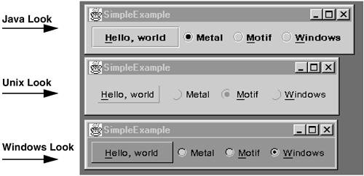
Containers, Layouts, and AWT Loose Ends
javax.swing.plaf.metal.MetalLookAndFeel
com.sun.java.swing.plaf.motif.MotifLookAndFeel
com.sun.java.swing.plaf.windows.WindowsLookAndFeel
UIManager.setLookAndFeel(
UIManager.getSystemLookAndFeelClassName());
UIManager.
setLookAndFeel
Notes:
try {
UIManager.setLookAndFeel("javax.swing.plaf.metal.MetalLookAndFeel");
} catch (Exception ex) {
ex.printStackTrace();
}

Slide 33
Model/View/Controller architecture
设计模式

Slide 34
Containers
Layout Managers implement layout policy
  Add components from left to right across the container. When you reach the right-hand margin, start a new line of them
  Or Components can go to the north, south, east, west, or in the center of the component. You have to tell me where you add one
Controls, containers, component...

Slide 35
Container
automatically position controls.
Forcing the layout to be done.
The thickness of any lines or insets (Borders) around its edges.
Adding a ContainerListener for ContainerEvents.
Adding, removing, and retrieving a list of any of the controls.
Size (current, preferred, minimum, and maximum).
Requesting the keyboard focus.
A paint() routine that renders it on the screen

Slide 36
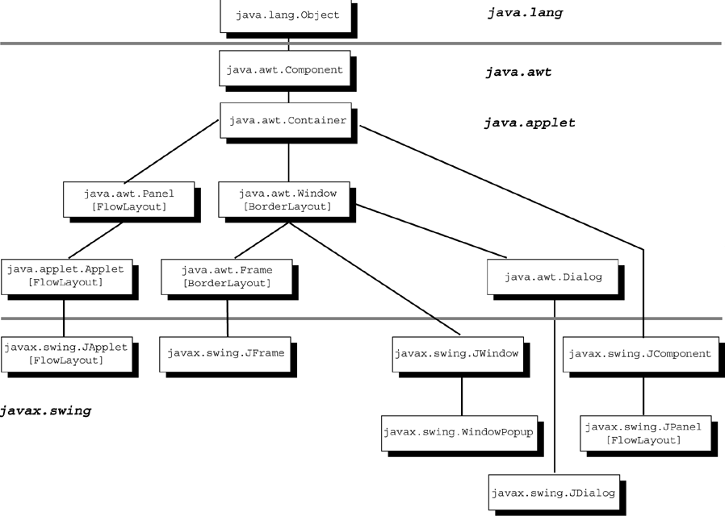
Container class hierarchy

Slide 37
Container code
Containers must have either their pack() method called or have their initial size set before they will show up on the screen
  public void setSize(int width, int height )
myContainer.invalidate(); // tell AWT it needs laying out
myContainer.validate(); // ask AWT to lay it out
myContainer.show(); // make it visible
myContainer.pack(); // squeeze it down smaller
myAWTContainer.add(myAWTComponent)

Slide 38
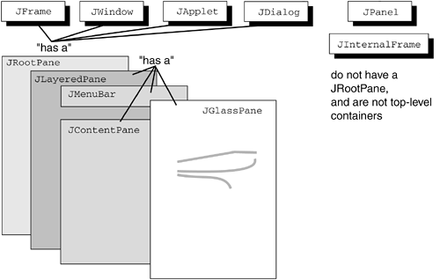
Layers of Swing containers

Slide 39
JFrame
A JFrame is a window that also has a title bar, a menubar, a border (known as the inset), and that can be closed to an icon.
  a separate free-floating window on the monitor
  // load the image from a file Toolkit
  Toolkit t = MyFrame.getToolkit();
  Image FrameIcon = t.getImage(filename);
  MyFrame.setIconImage(FrameIcon);

Slide 40
Menu
JMenuBar menuBar = new JMenuBar();
setJMenuBar(menuBar);
  在frame.setVisible()之前
JMenu fileMenu = new JMenu("文件");
menuBar.add(fileMenu);
JMenuItem menuOpen = new JMenuItem("打开");
menuOpen.setAccelerator(KeyStroke.getKeyStroke(KeyEvent.VK_O,InputEvent.CTRL_MASK));
fileMenu.add(menuOpen);
  demo
Notes:
import java.awt.*;
import java.awt.event.*;
import javax.swing.*;
public class NewClass extends JFrame{
static NewClass mainFrame=new NewClass("Menu file");
NewClass(String s) {
super(s);
}
public static void main(String[] args) {
mainFrame.setSize(640,480);
mainFrame.setDefaultCloseOperation(JFrame.EXIT_ON_CLOSE);
mainFrame.addMenu();
mainFrame.setVisible(true);
}
public void addMenu() {
// 菜单栏
JMenuBar menuBar = new JMenuBar();
// 设置「文件」菜单
JMenu fileMenu = new JMenu("文件");
JMenuItem menuOpen = new JMenuItem("打开");
// 快捷键设置
menuOpen.setAccelerator(
KeyStroke.getKeyStroke(
KeyEvent.VK_O,
InputEvent.CTRL_MASK));
menuOpen.addActionListener(new ActionListener(){
public void actionPerformed(ActionEvent e){
JFileChooser jfc=new JFileChooser();
jfc.showOpenDialog(null);
}
});
JMenuItem menuSave = new JMenuItem("保存");
menuSave.setAccelerator(
KeyStroke.getKeyStroke(
KeyEvent.VK_S,
InputEvent.CTRL_MASK));
JMenuItem menuSaveAs = new JMenuItem("另存为");
JMenuItem menuClose = new JMenuItem("关闭");
menuClose.setAccelerator(
KeyStroke.getKeyStroke(
KeyEvent.VK_Q,
InputEvent.CTRL_MASK));
fileMenu.add(menuOpen);
fileMenu.addSeparator(); // 分隔线
fileMenu.add(menuSave);
fileMenu.add(menuSaveAs);
fileMenu.addSeparator(); // 分隔线
fileMenu.add(menuClose);
// 设置「编辑」菜单
JMenu editMenu = new JMenu("编辑");
JMenuItem menuCut = new JMenuItem("剪切");
menuCut.setAccelerator(
KeyStroke.getKeyStroke(KeyEvent.VK_X,
InputEvent.CTRL_MASK));
JMenuItem menuCopy = new JMenuItem("复制");
menuCopy.setAccelerator(
KeyStroke.getKeyStroke(KeyEvent.VK_C,
InputEvent.CTRL_MASK));
JMenuItem menuPaste = new JMenuItem("粘贴");
menuPaste.setAccelerator(
KeyStroke.getKeyStroke(KeyEvent.VK_V,
InputEvent.CTRL_MASK));
editMenu.add(menuCut);
editMenu.add(menuCopy);
editMenu.add(menuPaste);
// 设置「关于」菜单
JMenu aboutMenu = new JMenu("关于");
JMenuItem menuAbout = new JMenuItem("关于JNotePad");
aboutMenu.add(menuAbout);
menuBar.add(fileMenu);
menuBar.add(editMenu);
menuBar.add(aboutMenu);
mainFrame.setJMenuBar(menuBar);
}
}

Slide 41
Menu cont.
menuOpen.addActionListener(new ActionListener(){
public void actionPerformed(ActionEvent e){
  JFileChooser jfc=new JFileChooser();
  jfc.showOpenDialog(null);
}
});

Slide 42
JPanel
A JPanel is a generic container that is always in some other container
the Swing JPanel isn't descended from the AWT panel. They still fulfill the same kind of role: to be a generic non-top-level container
provide automatic double buffering and the accessibility help

Slide 43
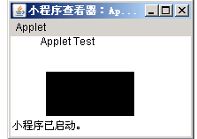
Applet and JApplet
Applet is a subclass of Panel.
JApplet is the Swing subclass of Applet.
Example
Appletviewer
  applet1.java
Rename to html
1.Applet的容器是谁？
2.普通GUI有容器么?
3.JSP的容器呢？ JavaBean呢？

Slide 44
import java.awt.*;
import javax.swing.*;
public class Applet1 extends JApplet {
  public void init(){
  resize(250,100);
  }
  public void paint (Graphics g){
  g.drawString(“Applet Test",34,10);
  g.fillRect(40,40,100,100);
  }
  }
<a href="Applet1.java">Applet1.java</a> <applet code=Applet1 width=200 height=400 codebase=example></applet>

Slide 45
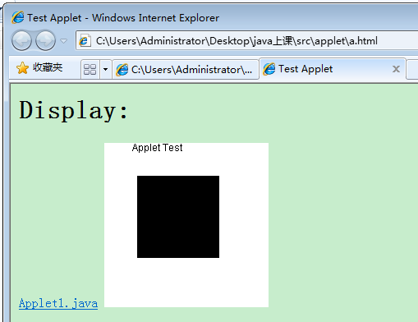
<title>
Test Applet
</title>
<H1>Display:</H1>
<a href="Applet1.java">Applet1.java</a> <applet code=Applet1 width=200 height=200 codebase=example></applet>

Slide 46
Popular Applet methods
applet life cycle:
  public void init()
  public void start()
  public void stop()
  public void destroy()
some popular methods of Applet:
  public URL getDocumentBase()
  public URL getCodeBase()
  public String getParameter(String name)
  public void resize(int width, int height)
  public void showStatus(String msg)
  public Image getImage(URL url)
  public Image getImage(URL url, String name)
  public static AudioClip newAudioClip(URL url)
  public void play(URL url)
Notes:
newAudioClip可以从internet上得到一个视频剪辑
Applet也可以处理图像

Slide 47
Window and JWindow
This container is a totally blank window
Typically, you don't use Window directly but instead use its more useful subclasses, Frame and Dialog.
The Swing class JWindow is really only there to help with pop-up menus.
can be modal

Slide 48
Null Layout(经典布局模式)
frame.setLayout(null);
a=new JButton("a");
b=new JButton("b");
a.setBounds(10,30,50,25);
b.setBounds(70,30,100,58);
frame.setSize(200,500);
  demon
Notes:
public static void main(String ars[]){
JFrame frame;
JButton a,b;
frame=new JFrame();//new Frame();
frame.setBounds(100,100,150,70);
frame.setBackground(Color.red);
frame.setLayout(null);
a=new JButton("a");
b=new JButton("b");
frame.add(a);
a.setBounds(10,30,50,25);
frame.add(b);
b.setBounds(70,30,100,58);
frame.setSize(200,500);
frame.setVisible(true);
}

Slide 49
Layout in a Container
setLayout( new FlowLayout() );
six layout managers:
  the five that are part of AWT and a sixth one that comes with Swing
FlowLayout
  left to right, keeping them centered in the container and starting a new line whenever necessary
  setLayout (new FlowLayout (FlowLayout.RIGHT));
  public FlowLayout(int align, int hgap, int vgap);
  Try resize window

Slide 50
Layout in a Container
GridLayout
  setLayout( new GridLayout(rows, cols) );
BorderLayout
  put four components around the four edges of the Frame, with a fifth component taking any remaining space in the middle
BoxLayout
  align a group of components horizontally or vertically
  new BoxLayout(c, BoxLayout.Y_AXIS)); //X_AXIS

Slide 51
Layout in a Container
Combining layouts Other layout managers
  p1.add( jck1 );
  p1.add( jck2 );
  p1.add( jck3 );
  p2.add( jb1 );
  p2.add( jb2 );
  c2.add(jl, "Center");
  c2.add(p1, "West");
  c2.add(p2, "East");
  P1 , P2 : BoxLayout.Y_AXIS

Slide 52
Other layout managers
GridBagLayout
  a variation of GridLayout.
  allows you to let a component take up the space of several adjacent grid positions.
SpringLayout
  similar to absolute positioning of Components
  feature of resizing appropriately to changes in container size or component fonts
setLocation (int x, int y).

Slide 53
JDK 1.4 image I/O
import javax.imageio.*;
File f = new File("bmw.jpg");
BufferedImage bi = ImageIO.read(f);
BufferedImage bi2 =(new Robot()). createScreenCapture(new Rectangle(0, 0, 200, 200));
Graphics2D big = bi2.createGraphics();
big.setPaint(Color.BLUE);
big.drawString ("Date: Oct 2004", 20, 60);
File f2 = new File("bmw2.jpg");
ImageIO.write(bi2, "jpg", f2);

Slide 54
More
The toolkit
  java.awt.Toolkit.getDefaultToolkit().
Printing the screen
  Package javax.print
Changing cursor appearance
  public synchronized void setCursor(Cursor cursor )
  this.setCursor(new Cursor(Cursor.HAND_CURSOR) );
  Cursor createCustomCursor(Image cursor, Point hotSpot, String id) throws IndexOutOfBoundsException

Slide 55
Visual IDE
NetBeans
MyEclipse
JBuilder

Slide 56
实习三
Notes:
Save:
File file = new File(getTitle());
BufferedWriter buf = new BufferedWriter( new FileWriter(file));
// 将文字编辑区的文字写入文件
buf.write(textArea.getText());
Read:
// 开启选取的文件
BufferedReader buf = new BufferedReader( new FileReader( fileChooser.getSelectedFile()));
while((text = buf.readLine()) != null) { textArea.append(text); textArea.append(lineSeparator); }
JDialog :
jof.setModal(true);

